Slide 1
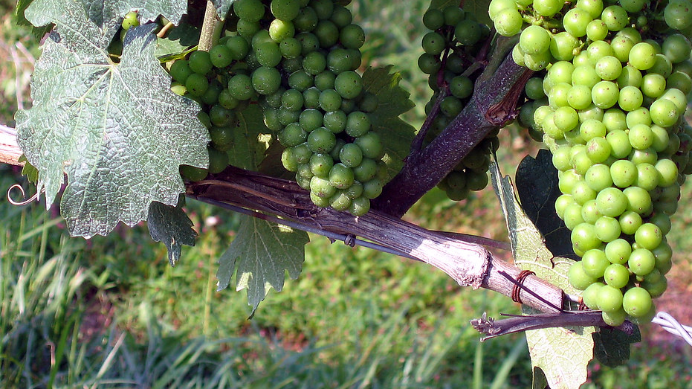
Predicting the Quality of White Wine
Bryan D’Amico
ist 707

Slide 2
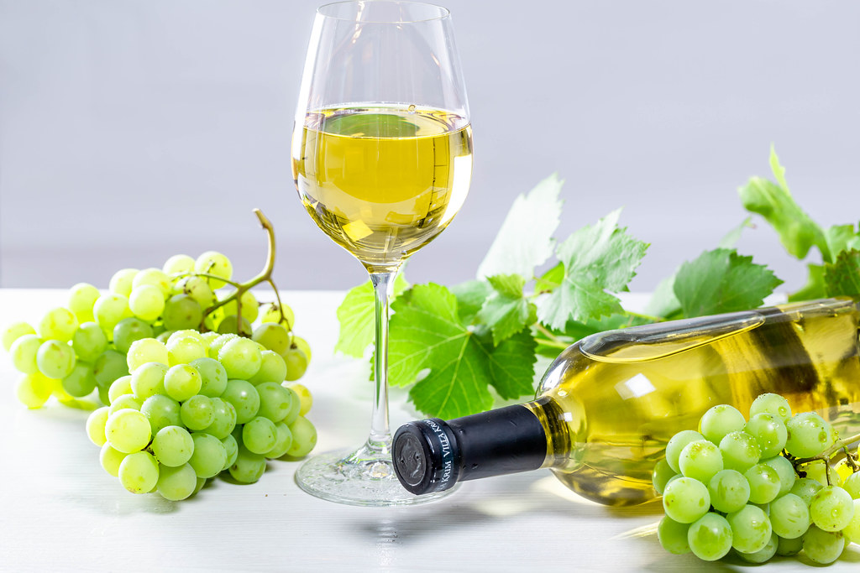
Agenda
Topic Introduction
Goals of the Analysis
Five Key Analyses with Results
Final Conclusions
Time for Q&A
Notes:
This presentation will include an introduction of the data set as well as the goal of the analysis. Five key results will be highlighted based on the different models that were created. After that, I will share some of the final conclusions for this analysis and we will have some time for questions if there are any.

Slide 3
About the Data Set – the topic
Based on the Portuguese Vinho Verde wine
Privacy and logistic limitations prevent inclusion of information on grape types, wine brand, selling price, etc.
The input variables are the results of objective scientific tests and measurements
The output variable is the quality rating of the wine as assigned by expert judges
Notes:
This data set was based on the Portuguese Vinho Verde which is known for being a very good quality wine for the price. The scope of the data set was limited by the vineyard to exclude information about their grapes, the individual brands, their prices and other information that specifically identifies products they sell. The input variables were all results of scientific tests performed on samples of the wine, and the output variable was the quality rating of the wine given by expert judges.

Slide 4
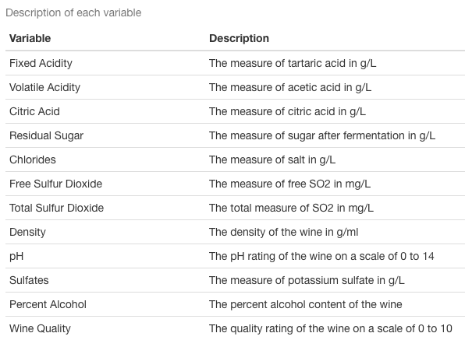
About the Data Set – the variables
Notes:
Here is a quick summary of the variables found in the data set. Measurements were taken regarding the levels of chemical compounds in the wine such as different acids, sugar, salt, and sulfur dioxide. The pH level, density, and alcohol percentage of each wine sample was included as well. Each wine is rated on a scale from 0 to 10 and that score was calculated by taking the median value of at least 3 scores given to the wine by different judges.

Slide 5
Goals of the analysis
Understand how physiochemical attributes relate to wine quality
Predict wine quality rating based on physiochemical test results
Notes:
The goals of this analysis were to gain more insight into how the physiochemical input variables relate to the quality of the wine and to hopefully predict the wine quality rating based on those input values. This analysis asked the computer if it was able to discern wines just by looking at numbers in the same way that a person does by actually tasting it.

Slide 6
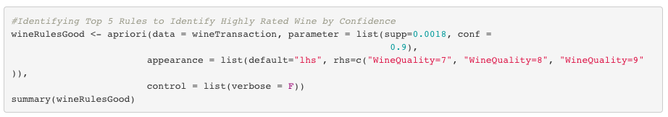
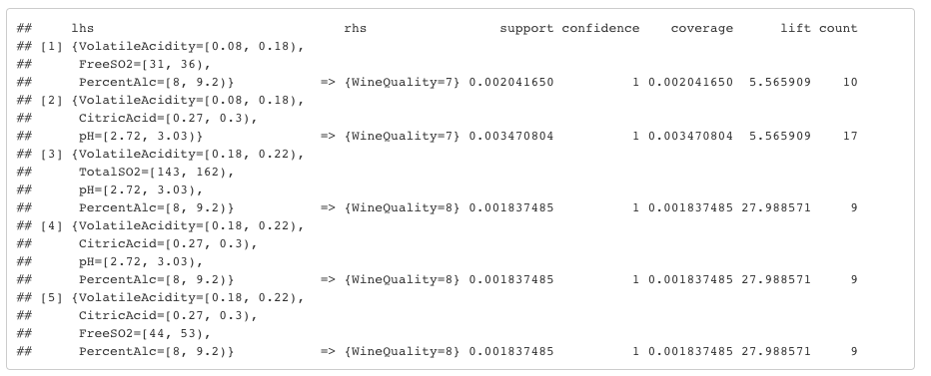
Association Rule mining
Targeting rules with right hand sides that contained wine quality ratings
Low volatile acidity, low pH, low percent alcohol, and medium amount of citric acid will often result in a high quality wine
Notes:
The analysis includes many different rounds of association rule mining, but the one that I wanted to highlight was when I made the right hand side have to be a wine quality rating of 7, 8, or 9. I called this group of quality ratings the good wines. Rules were also mined for the average wines (rated a 5 or 6) and for poor wines (rated a 3 or 4). Based on the similarities between the rules targeting good wines, I was able to come up with a general association. Low volatile acidity, low pH, low percent alcohol and medium levels of citric acid lead to the judges giving the wine a good score.

Slide 7
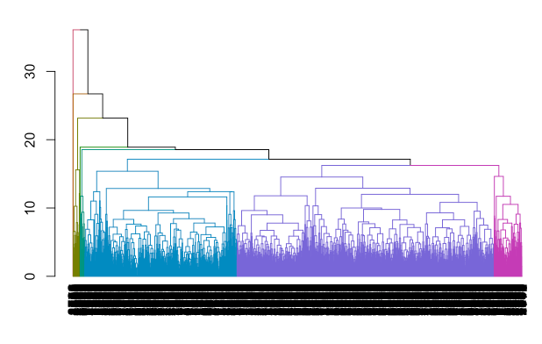
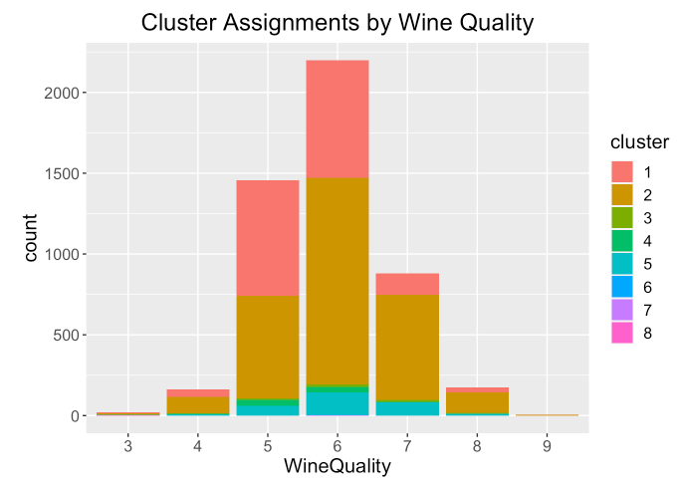
Hierarchical agglomerative clustering
Goal was to have clusters recreate the wine quality groups
Model uses Minkowski distance measure
Samples are spread throughout all clusters
Clusters do not match wine quality groups
The method or data may not support the goal of the analysis
Notes:
I also created clustering models to see if the models could recreate the wine quality groups. Unfortunately, they were not able to. The model I am showing here is a good summary of what happened with all the clustering models. Since there are almost 5000 data examples, I used a color dendrogram to visualize the clusters in an understandable way. I then translated that into a bar chart and as you can see all the wine quality ratings are dispersed throughout the different clusters. At this point I was starting to wonder if the clustering method just did not fit this task, or if the data did not support the goal of predicting the wine quality ratings.

Slide 8
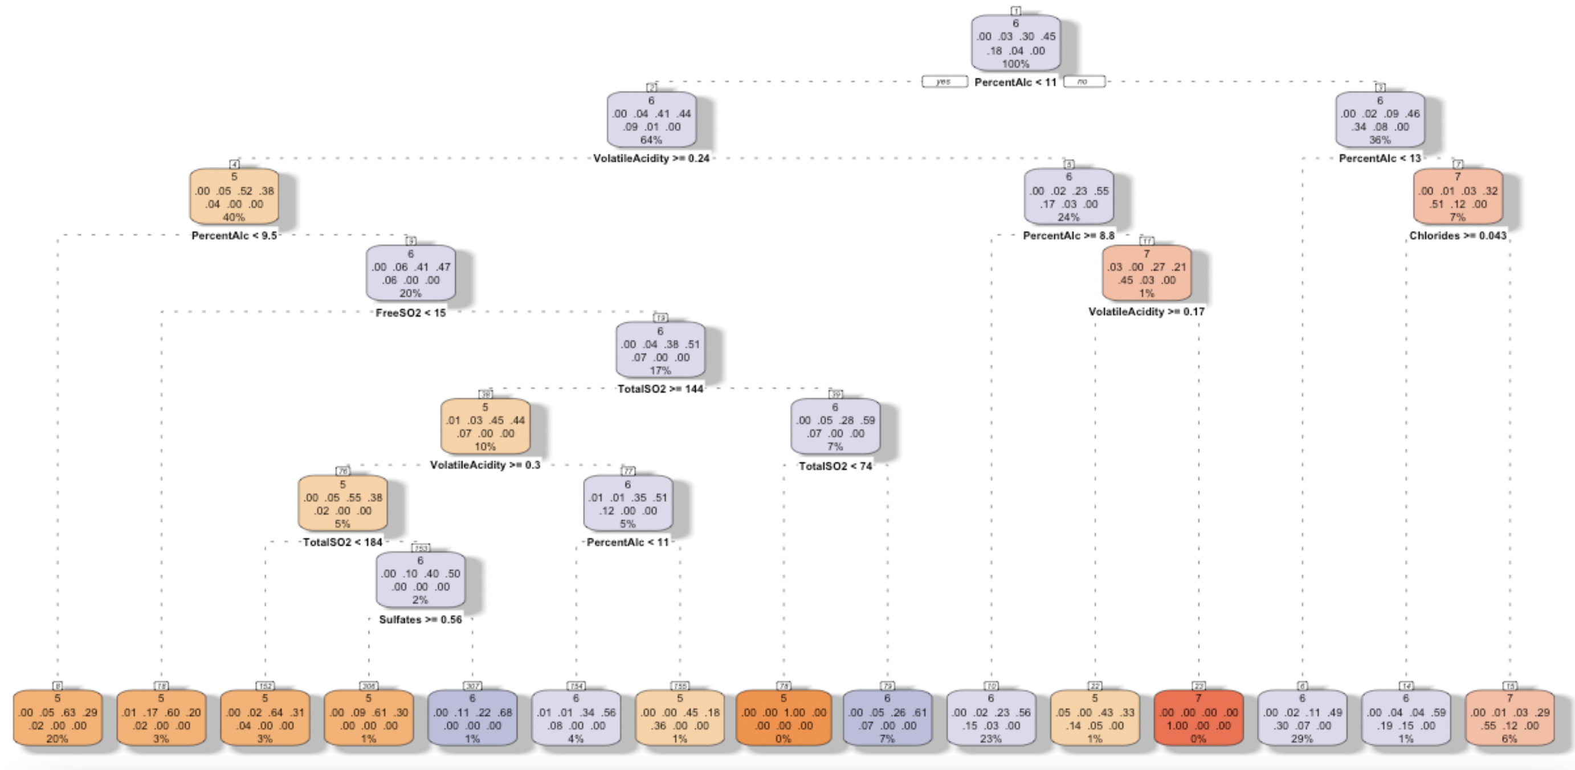
DECISION TREE CLASSIFICATION
Notes:
I wanted to highlight a decision tree model, so before I talk about it, here is the full decision tree.

Slide 9
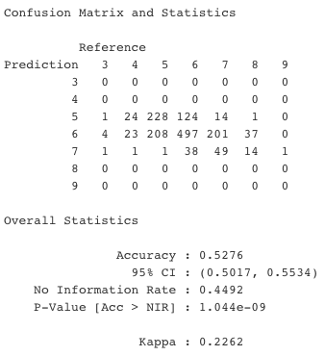
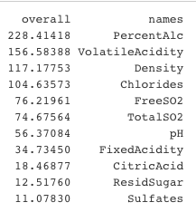

DECISION TREE CLASSIFICATION
Only predicts ratings of 5, 6, or 7
Only ~50% accuracy when classifying wines that are rated 5
Almost always wrong when classifying wines that are rated 7
PercentAlc, VolatileAcidity, Density, Chlorides were most important variables when determining outcomes of tree
VARIABLE IMPORTANCE
Notes:
Unfortunately, the decision tree had major problems as well. This model only predicts ratings of 5, 6, or 7. And even then it has pretty poor accuracy when doing so. I also investigated the variable importance for the decision tree. Since these models were not working out to have the accuracy I had hoped for, I used this as an opportunity to see what was important while making the predictions as a way to start plan for a possible future analysis.

Slide 10
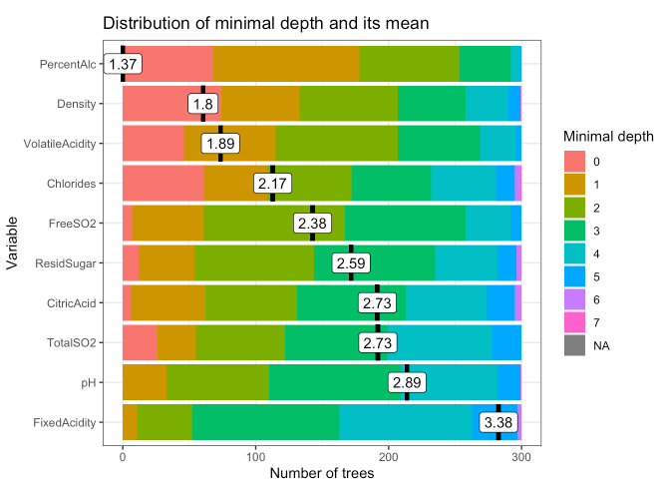
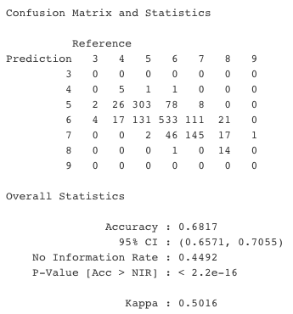
Random forest classification
300 Tree Model
Highest Accuracy – 68.17%
Better than single decision trees
Can correctly classify wines rated as 4 or 8
Better accuracy when predicting wines rated as 5 or 7
Notes:
Next I wanted to show the best result from my random forest models to show how greatly improved the accuracy is over the single decision tree model. The random forest actually had the highest accuracy out of all the models. This one used 300 trees and I had finally found a model that would at least try to correctly classify wines rated as a 4 or an 8. Also, the accuracy when predicting wines rated a 5 or 7 improved as well. The plot on the screen shows the mean minimal depth, the distribution of depths, and the number of trees that each variable was featured in. This lets us know that for example, the percent alcohol is the initial split more than any other variable, and the decision trees usually make one of their last decisions according to the value of fixed acidity.

Slide 11
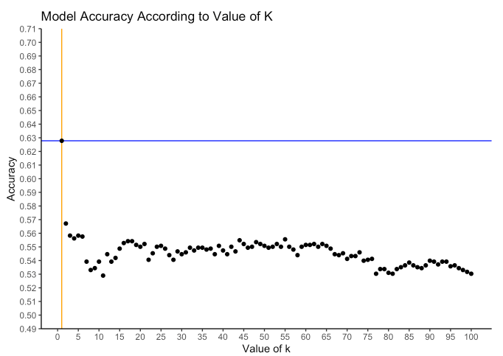
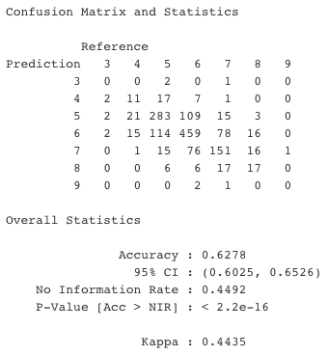
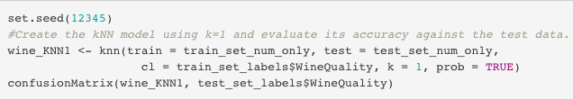
K nearest neighbor classification
K=1 provided best accuracy
One of the only models to make a prediction corresponding to every quality rating
Better at classifying wines rated 5, 6, or 7
Poor accuracy classifying wines rated 4 or 8
Notes:
The final model I wanted to highlight was the k nearest neighbor classification. For this model I used a for loop to create a model for every value of k from 1 to 100 and found that k=1 actually gave the best results. This was the second most accurate model at 62.78% and was one of the only models to attempt to correctly classify every quality rating. This model was better than the others at classifying wines rated as a 5, 6, or 7, but not as good with wines rated a 4 or 8.

Slide 12
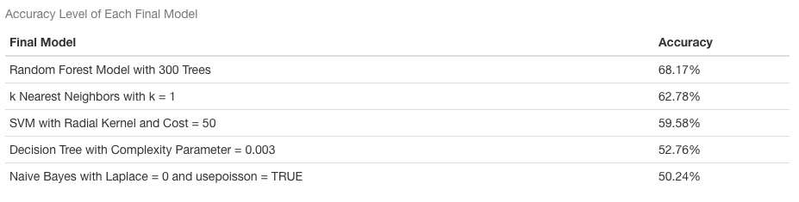
Summary of classification model accuracies
Notes:
This table shows the accuracy of the best model from each type of model. As you can see naïve bayes was actually the worst. One of the less tuned naïve Bayes models was actually worse than the no information rate model. And again, random forest had the best accuracy, but none of these accuracies were particularly impressive.

Slide 13
Conclusions and next steps
Data set may not be appropriate for predicting the wine quality ratings
The way the scores are assigned may prevent accurate classifications
Unbalanced data highlights limitations of clustering and classification models
May just be a very difficult task to predict wine quality ratings
For possible future investigations
Data set rebalanced to have an equal number of wine samples from all quality ratings
New study conducted using different input variables
Predicting the scores of a single judge instead of the combined median scores
Notes:
After thinking about all the results I had several ideas for what limited the performance of the models. First maybe the data set is just not great for successfully classifying the wines by their quality ratings. Second, it could the median scores from the judges that are preventing the classifications. A single wine could get a rating of 2 from one judge and a 10 from another and all that is going to be hidden from the data set, and that could explain why there are not clear differences in the input variables according to the quality ratings. This data set was also very unbalanced. There were very few highly rated and low rated wines which makes it tough for classification models. And my last thought was maybe this is just a really hard problem and I should view an accuracy of 68% to be a greater success than I am. For possible future investigations that aim to fix some of these potential issues, the data set could be rebalanced, a new study could be conducted recording different input variables, or the problem could be changed to try to predict the scores of only a single judge.

Slide 14
Time for q&A
Are there any questions regarding
The models used?
The results of the analyses?
The data preparation process?
The limitations of the analysis?
Anything else?
Notes:
Thank you for time and attention. Are there any questions?

Slide 15
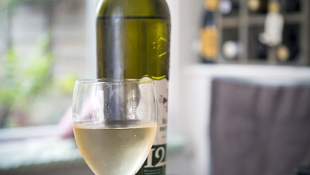
Thank you
For now, continue to trust human reviews when picking out your next wine to try

